Slide 1
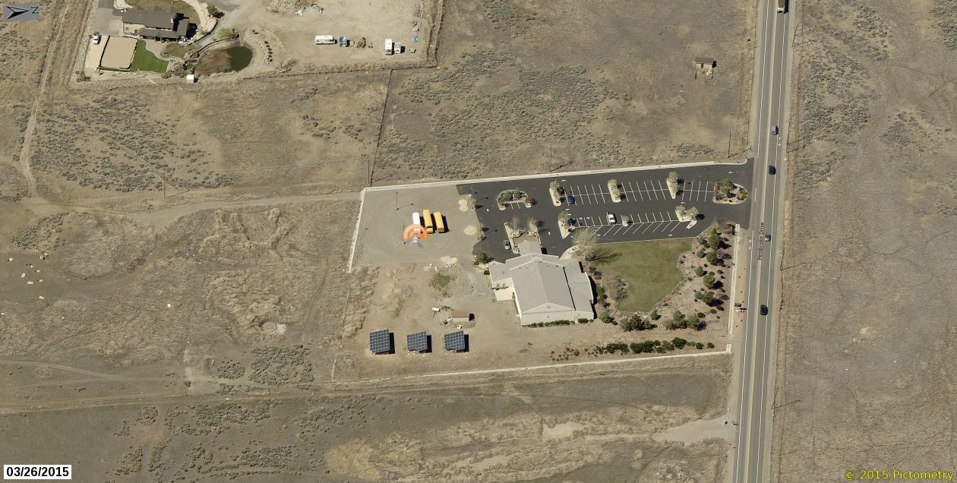
WSUP18-0007 (T-Mobile)
Washoe County Board of Adjustment
October 4, 2018

Slide 2
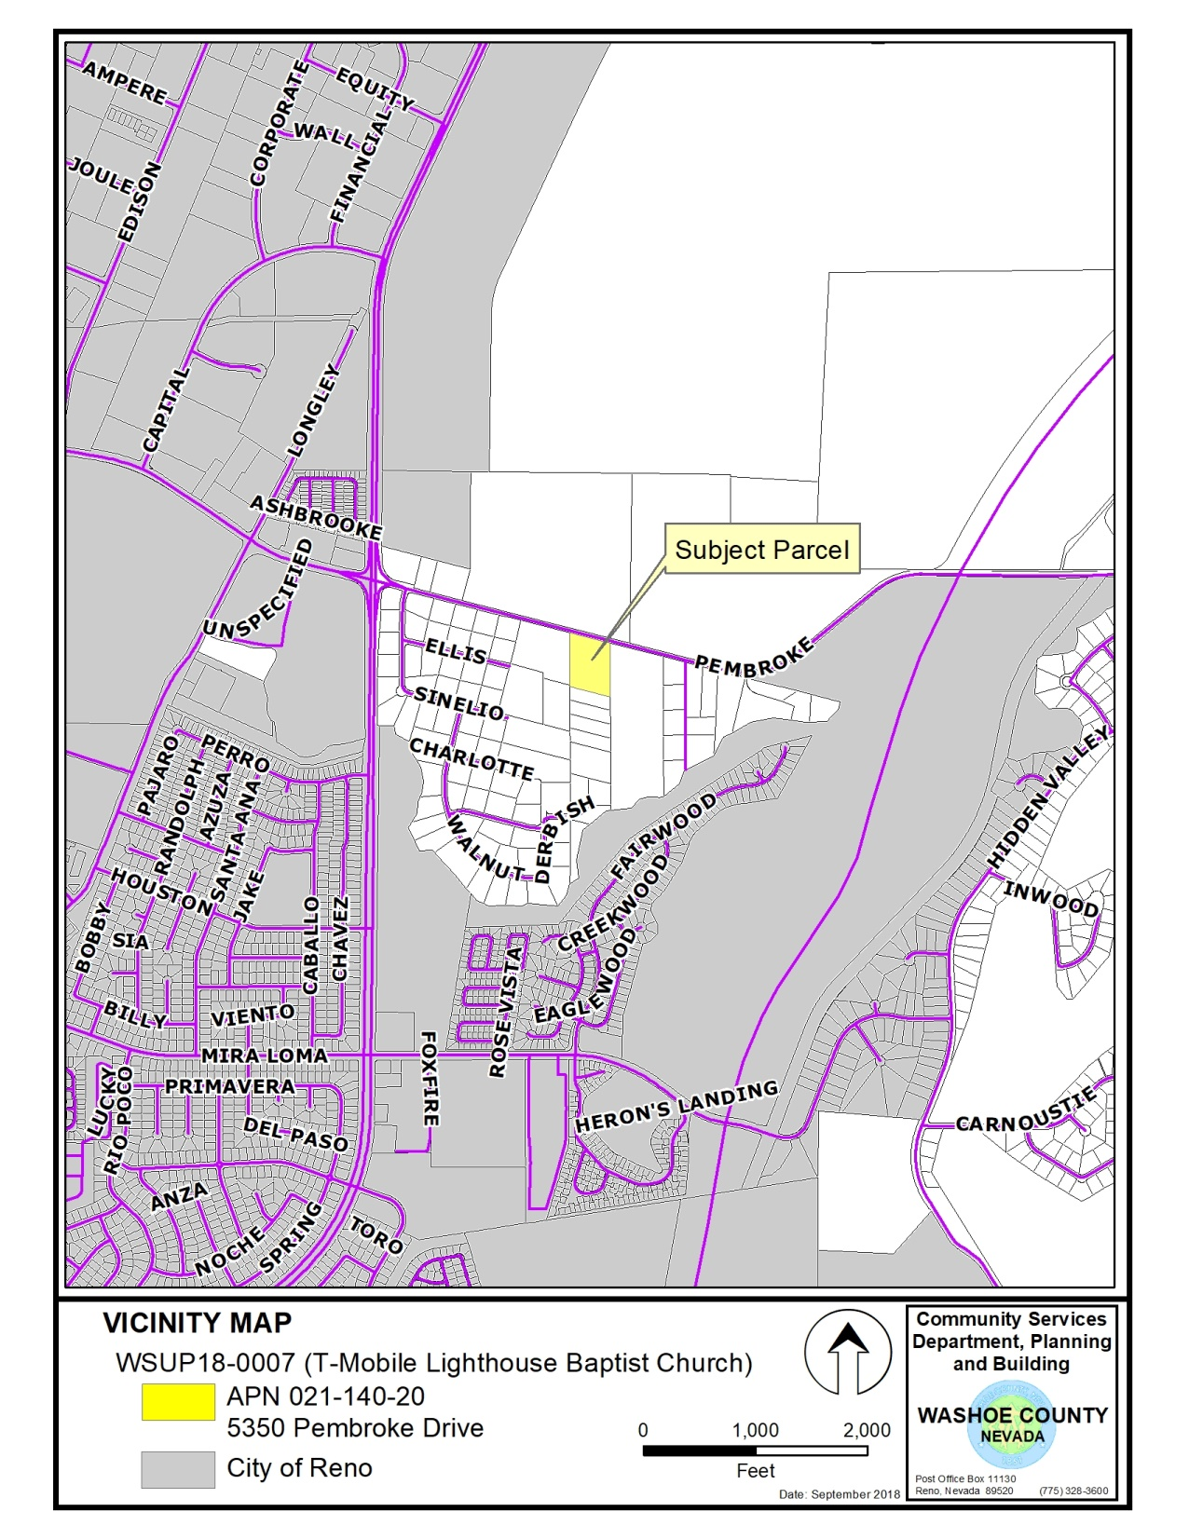
5350 Pembroke
APN 021-140-20

Slide 3
Background
Proposed to improve T-Mobile cellular coverage and data speeds in the Hidden Valley vicinity
Facility would also potentially improve E911 service
Would be located on a parcel owned by the Lighthouse Baptist Church of Reno
T-Mobile has been trying to locate a facility in the area for over two years

Slide 4
Background
T-Mobile explored 4 alternative locations throughout the Hidden Valley area of interest (aka the “search ring”)
These sites either did not satisfy service objectives or did not have willing leasers (owners)
Previously approved SUP for an integrated 55 foot high steeple facility (built into the church) was not built due to cost

Slide 5
Background
4-acre parcel – General Rural (GR) regulatory zone
The site is surrounded by other GR parcels that are mostly vacant
Existing non-conforming lot – new uses may be added if they meet code
Subject parcel is in the 100-year (1% chance) floodplain (thus the GR zoning)

Slide 6
Background
A “significant gap” (per 110.324.55) is not being claimed nor demonstrated
Standard review parameters regarding height and location for locating in GR regulatory zone
Proposing to use “stealth design” in the form of a pine tree (a.k.a “monopine”) – antenna arrays will be screened by faux branches
Ground equipment located inside 7 foot stucco wall enclosure matching the church building

Slide 7
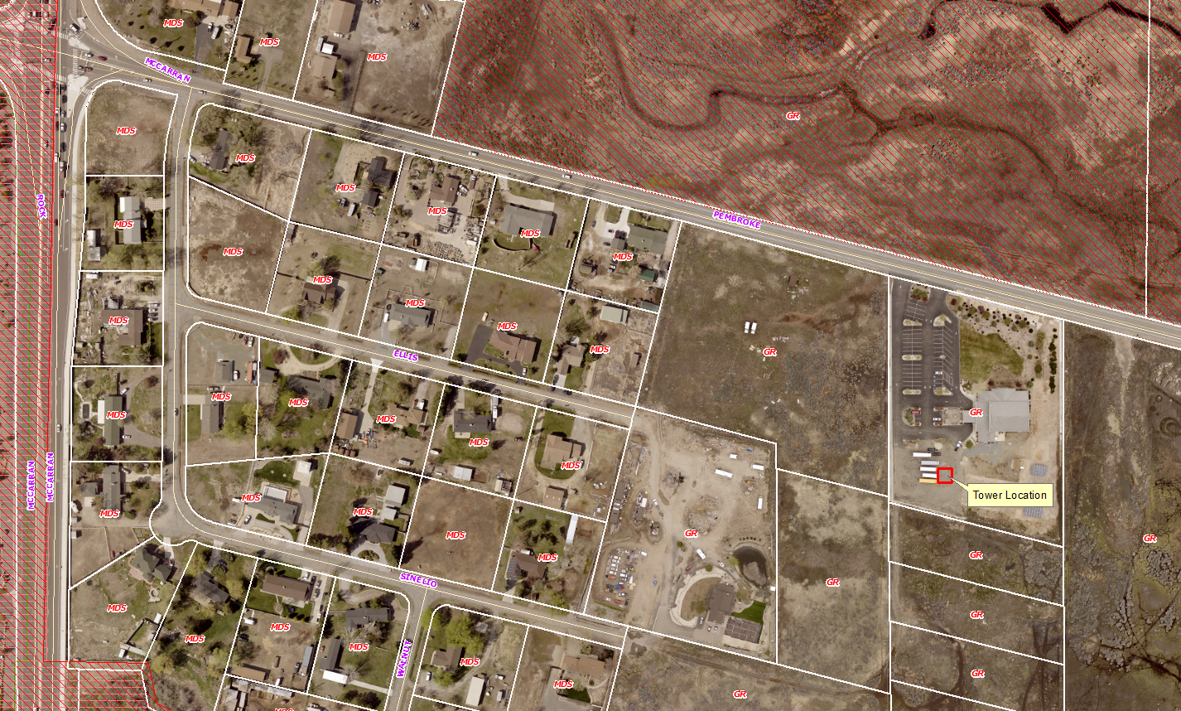
Vicinity Map - Aerial

Slide 8
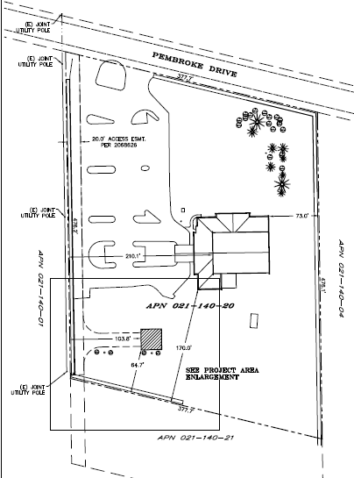
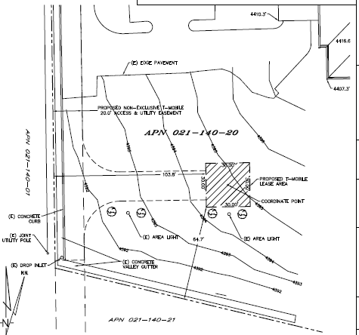
Site Plan

Slide 9
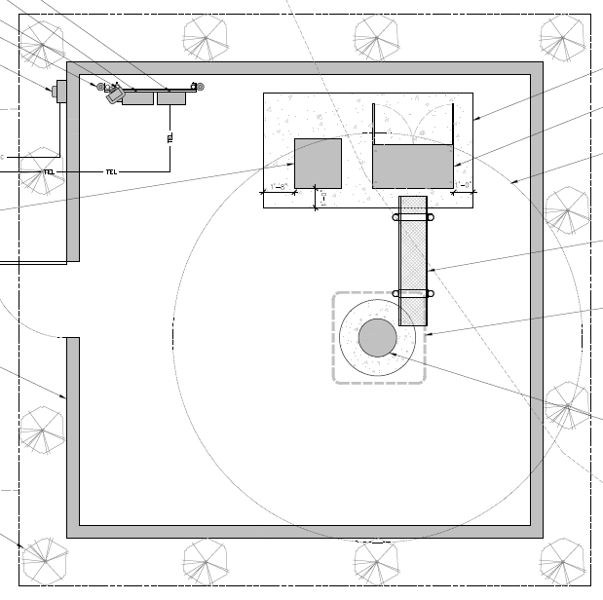
Site Plan – Equipment Enclosure

Slide 10
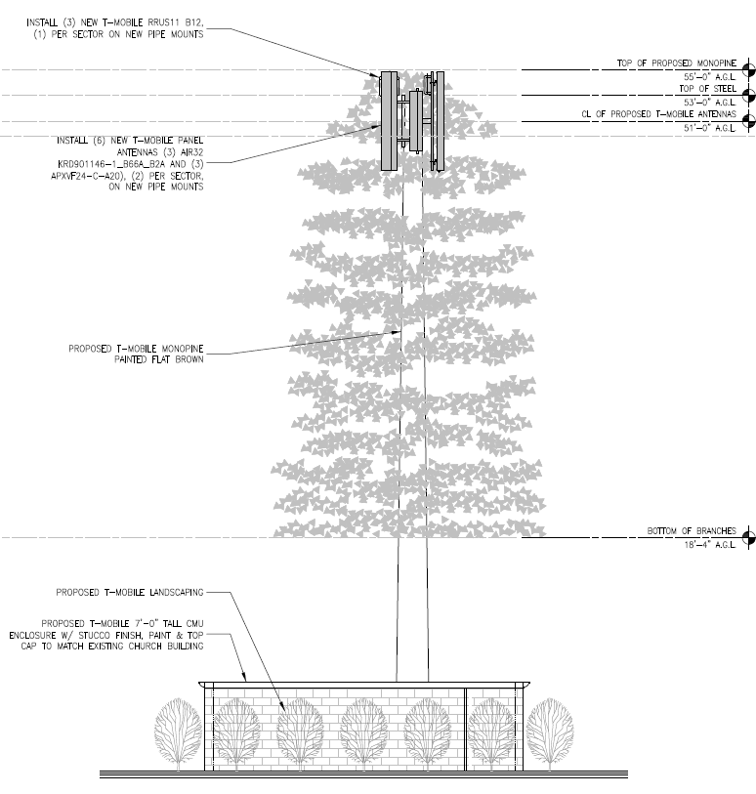
Elevations

Slide 11
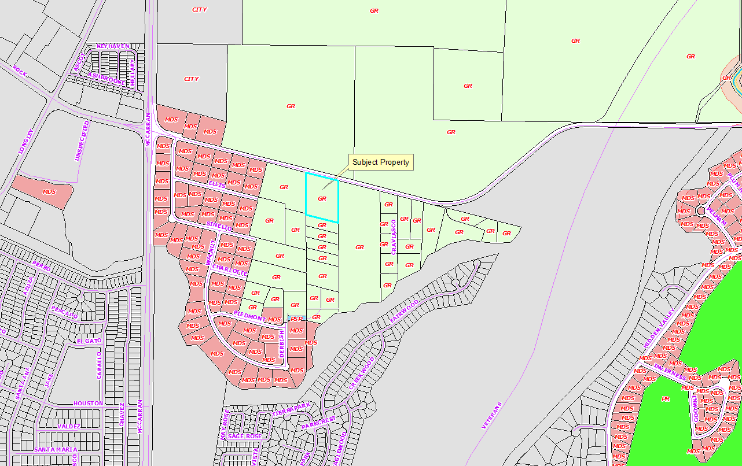
Adjacent Uses and Zoning

Slide 12
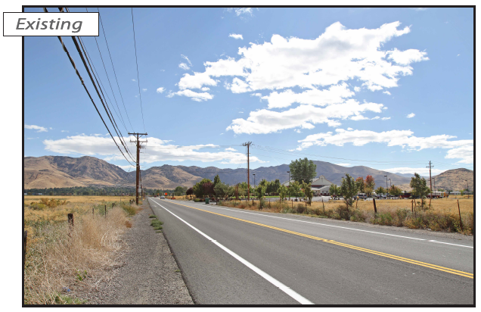
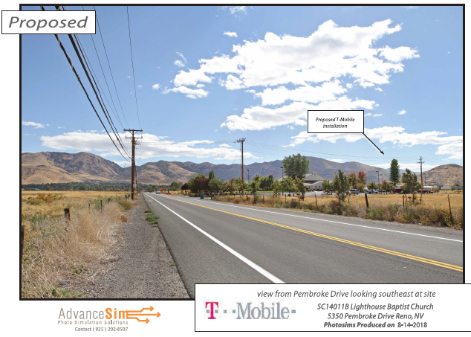
Photo Simulations
View from Pembroke looking southeast

Slide 13
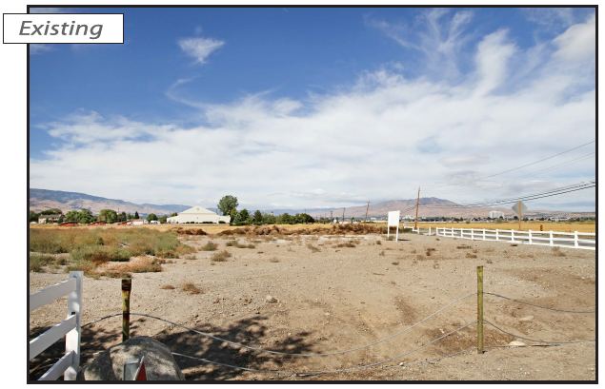
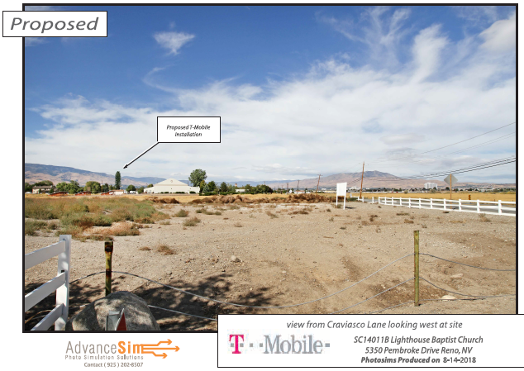
Photo Simulations
View from Craviasco Ln. looking west

Slide 14
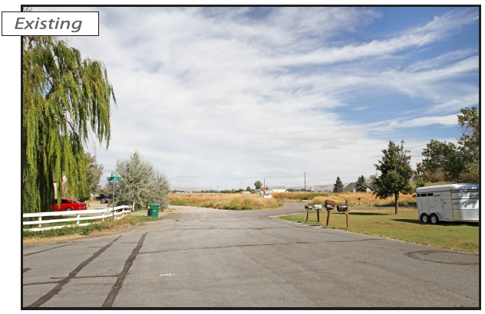
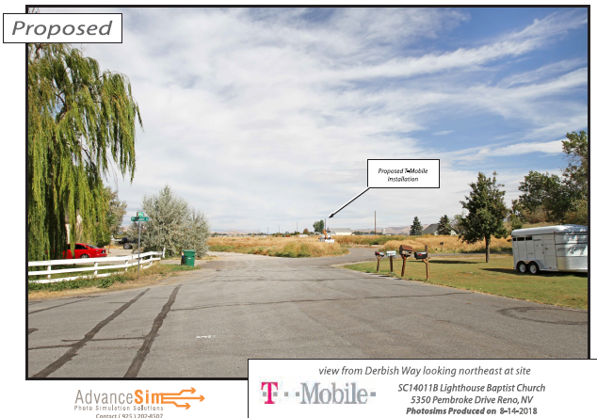
Photo Simulations
View From Derbish Way looking northeast

Slide 15
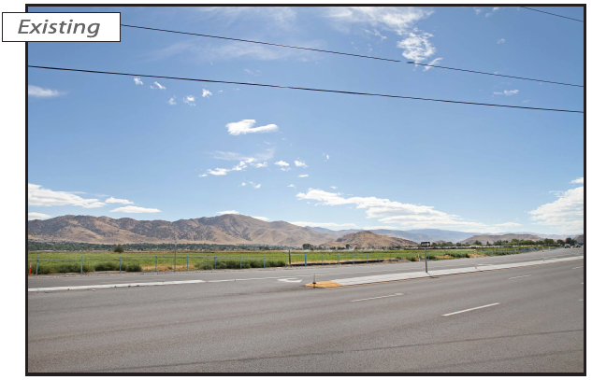
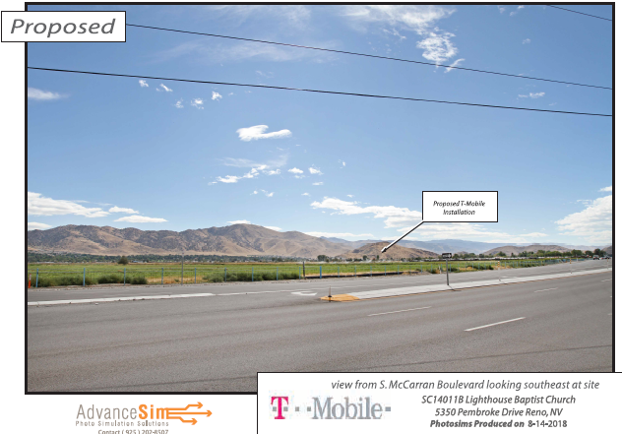
Photo Simulations
View From S. McCarran Blvd. looking southeast

Slide 16
Analysis – Height and Visual Impact
Proposed tower height of 55 feet meets code
The allowed height (in GR) is governed by the placement standards of WCC Table 110.324.50.1
The tower is approx. 400 feet from Pembroke

Slide 17
Analysis – Height and Visual Impact
As shown by the table, allowed height is based on the distance from residentially zoned property or public paved ROW, whichever is closer
GR is not a residential regulatory zone
Therefore the closest adjacent standard is the paved ROW of Pembroke Dr.
Monopine pole is considered a “stealth” design, therefore by code an additional 25 percent in height would also allowed (but is not needed)

Slide 18
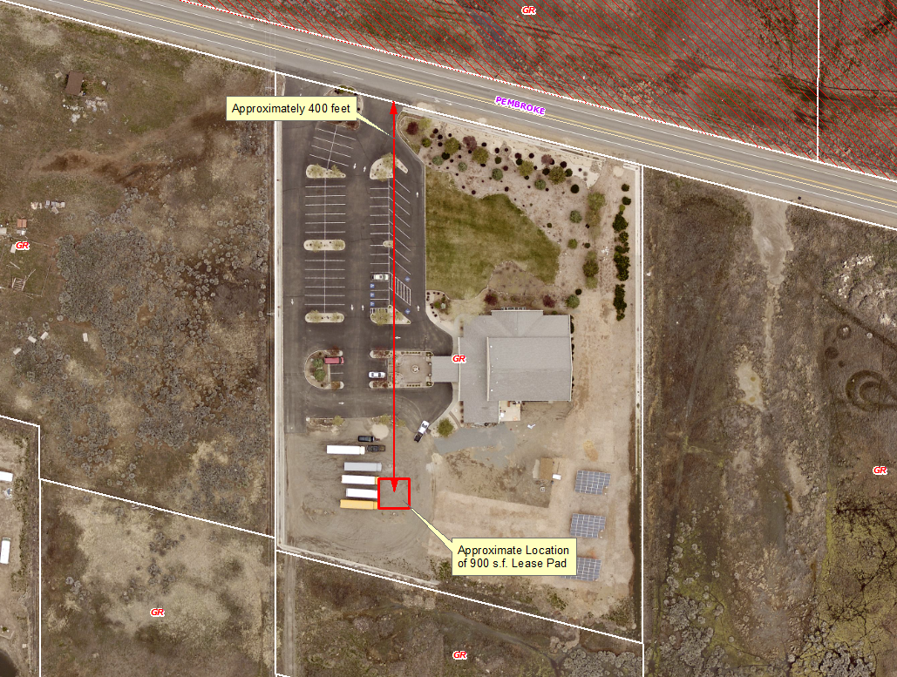
Analysis – Height and Visual Impact

Slide 19
Analysis – Height and Visual Impact
No significant ridgelines would be impacted
Is not within 1,000 feet of any public trail
The pad site is already disturbed / graded
There are no other poles or cellular facilities in the vicinity
Reflective materials will not be allowed – pole will be painted a neutral color (tan)
View from east has backdrop of large mature trees, trees partially screen view from the west

Slide 20
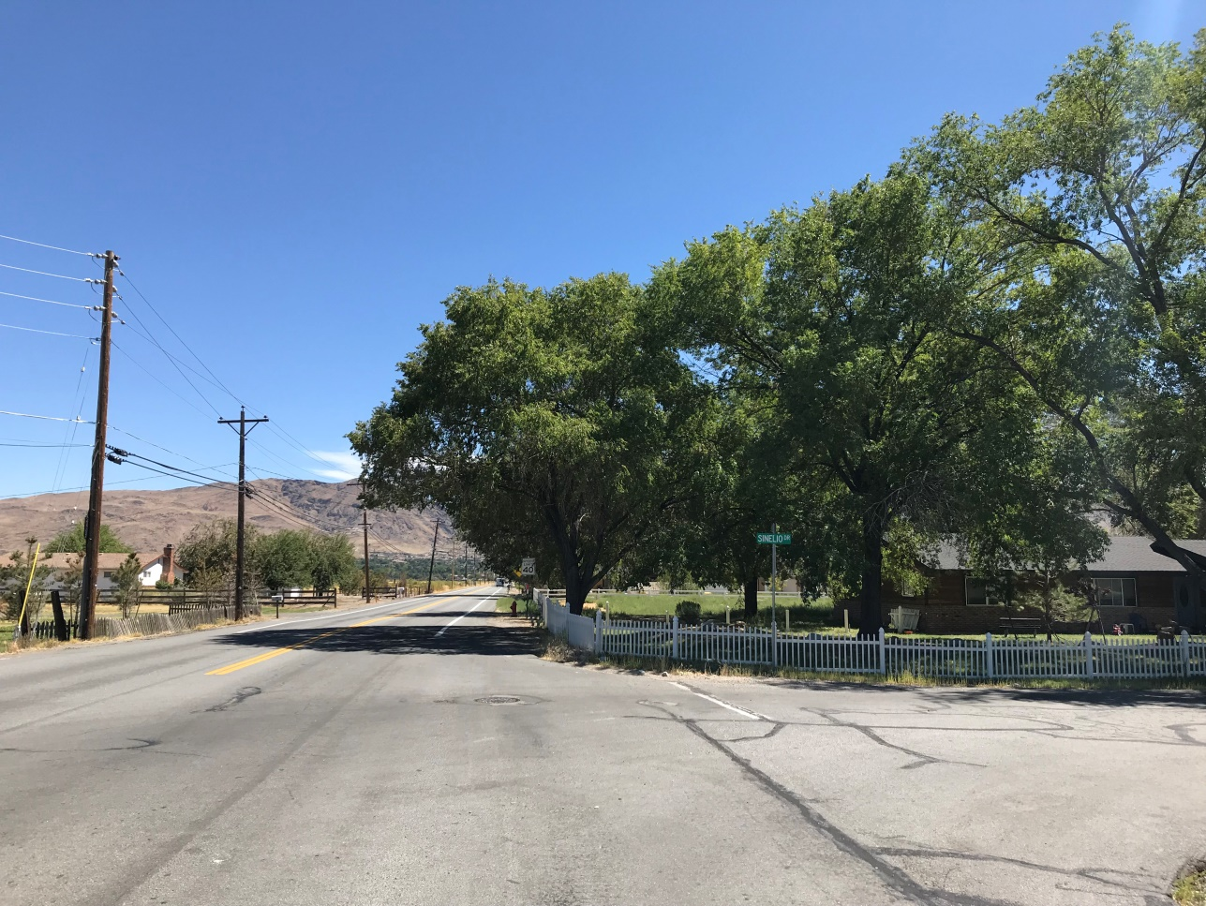
Analysis – Height and Visual Impact
Pembroke Dr. looking east at the intersection with McCarran Blvd.

Slide 21
Analysis – Zoning and Setbacks
The use is allowed by SUP in the General Rural regulatory zone
The facility has been designed to accommodate future collocation of additional carriers
The proposed location meets the required structure setbacks (i.e. 30’ F/R, 50’ side – 66 feet from west property line due to 36’ easement)
The facility is approximately 480 feet from the nearest dwelling

Slide 22
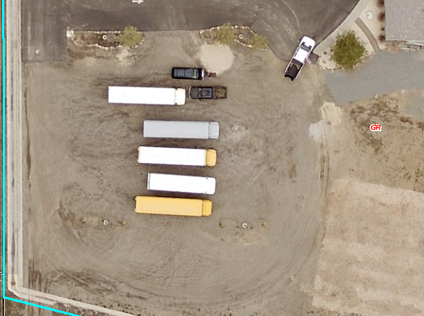
Analysis – Access and Grading
Minimal grading should be required
Pad will be located in an area that is already disturbed / graded:

Slide 23
Analysis – Access and Grading
Existing access to the pad is available off of Pembroke Dr. through the church parking lot
A 20 foot wide access easement will be granted to T-Mobile to ensure future access
Improvements will include a gravel approach to the pad commencing at the edge of parking lot pavement
Since the facility will be unmanned, no parking improvements are proposed (but space avail.)

Slide 24
Analysis – Utilities and Landscaping
Utility lines to the facility will be placed underground and within easements
Lighting will be minimal – one down shielded motion sensor light
Landscaping will be provided around the exterior of the 7 foot stucco wall enclosure (oleander bushes)

Slide 25
Analysis
Federal Aviation Regulations (FAR) Part 77 will be triggered (less than 4,500 from Runway 7/25)
T-Mobile has submitted the required Obstruction Analysis filing with the FAA – airspace determination pending (could result in safety lighting)
Project must comply with Article 416 Flood Hazards to mitigate any impacts to the 100 year floodplain
Engineering condition of approval to ensure compliance

Slide 26
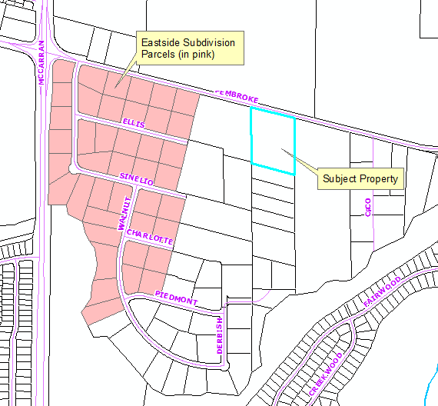
Analysis – Area Plan
Policy SETM.3.4 – prohibits commercial development in the Eastside Subdivision
Project is not within this subdivision, as shown below:

Slide 27
Alternative Site Analysis
Alternative sites considered included:
City of Reno golf course
Hidden Valley Regional Park
TMWA water tank
7415 Native Dancer Place
See detailed explanation on Page 20 of the Staff Report

Slide 28
Reviewing Agencies
The following reviewing agencies requested conditions of approval:
Planning and Building
Land Development, Engineering and Capitol Project Division
Reno-Tahoe Airport Authority
See Exhibit A of the staff report for the recommended conditions of approval

Slide 29
Citizen Advisory Board/Public Comment
The South Truckee Meadows/Washoe Valley Citizen Advisory Board reviewed the application on September 6, 2018
The CAB did not have any substantive comments and unanimously recommended approval
Staff has not received any comments from noticed adjacent property owners or the general public

Slide 30
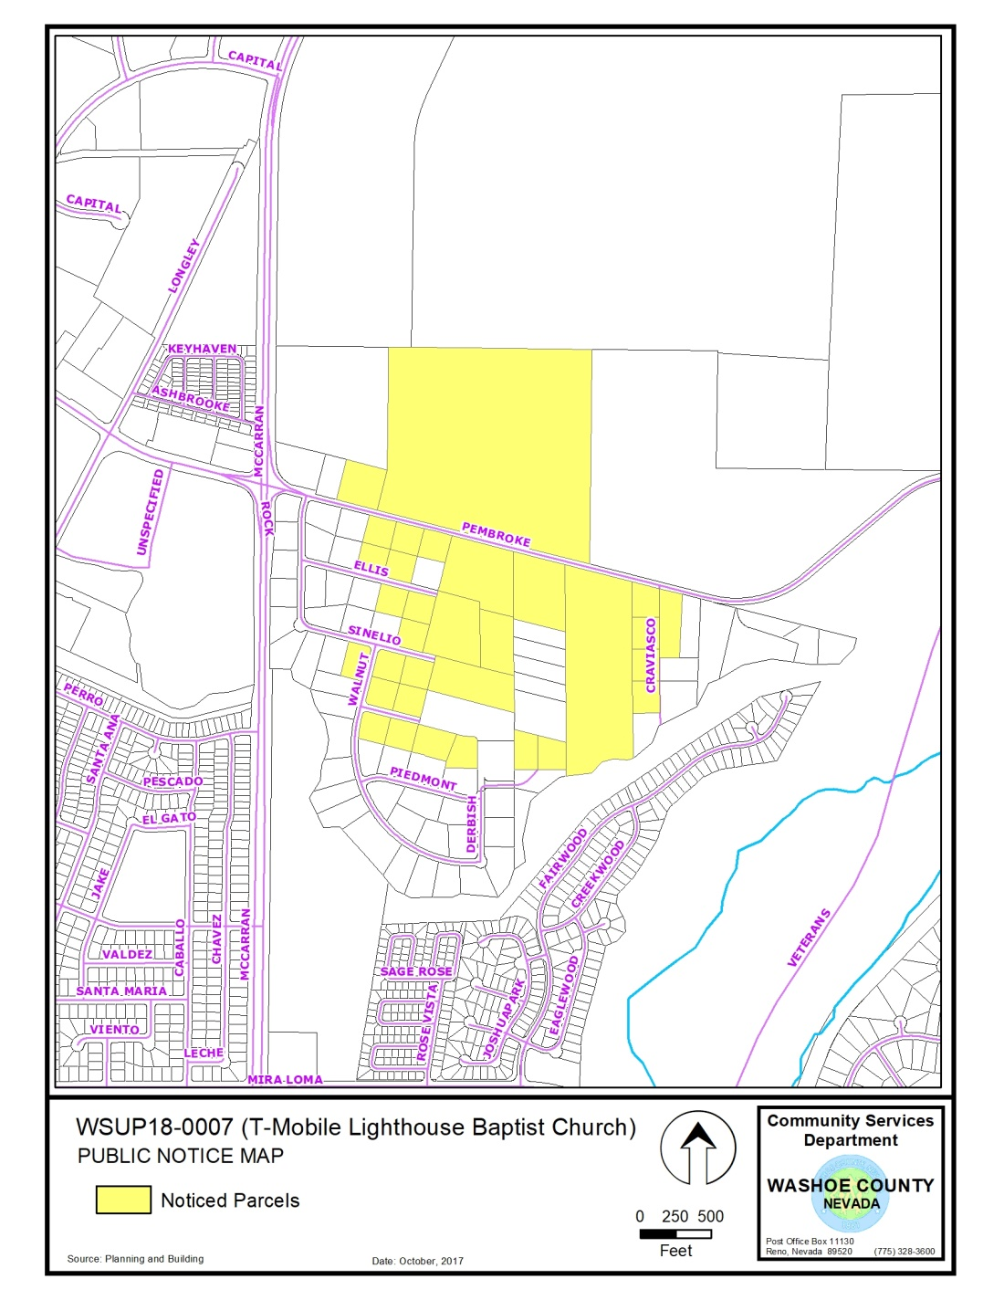
Mailing Notice Map
A minimum of 30 parcels were noticed

Slide 31
Required Findings
WCC Section 110.810.30, Article 810 Special Use Permits (Consistency with Master Plan, Adequate Improvements, Site Suitability, Issuance Not Detrimental, Effect on Military Installation)
WCC Section 110.324.75, Article 324 Communication Facilities (Meets Standards, Public Input, Impacts)
Consistency with the Southeast Truckee Meadows Area Plan

Slide 32
Required Findings
Staff analysis is provided in the staff report starting on page 22
Staff is able to make all of the required findings

Slide 33
Staff Recommendation
After a thorough analysis and review, Special Use Permit Case Number WSUP18-0007 for T-Mobile (Lighthouse Baptist Church) is being recommended for approval with conditions.

Slide 34
Possible Motion
I move that, after considering the information contained within the staff report and the information received during the public hearing, the Washoe County Board of Adjustment approve, with the conditions included at Exhibit A to the staff report for this item, Special Use Permit Case Number WSUP18-0007 for T-Mobile (Lighthouse Baptist Church), being able to make the findings required by Washoe County Code Section 110.810.30, Section 110.324.75, and consistency with the Southeast Truckee Meadows Area Plan.

Slide 35
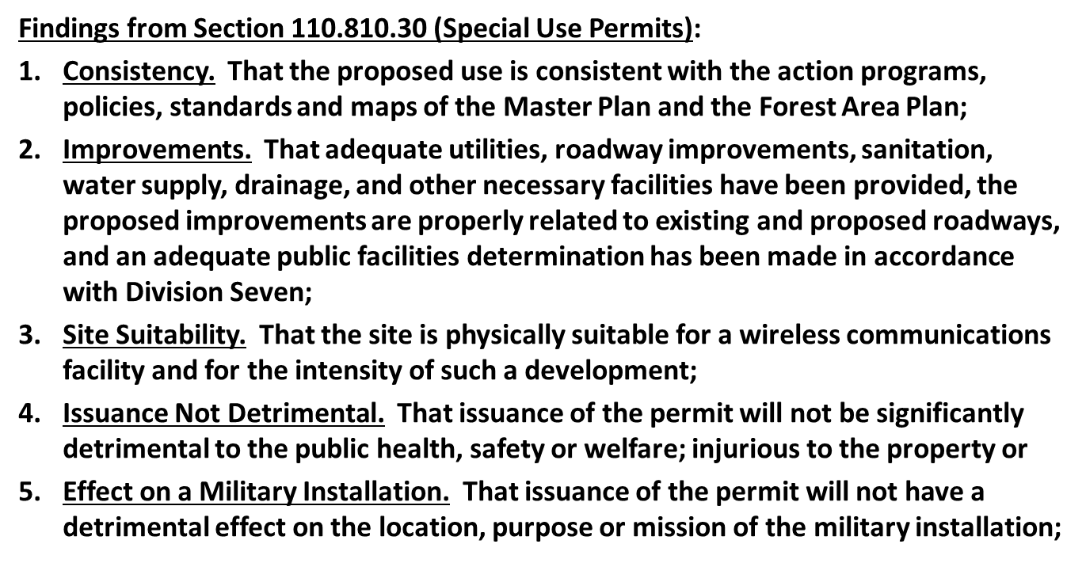
Motion Findings

Slide 36
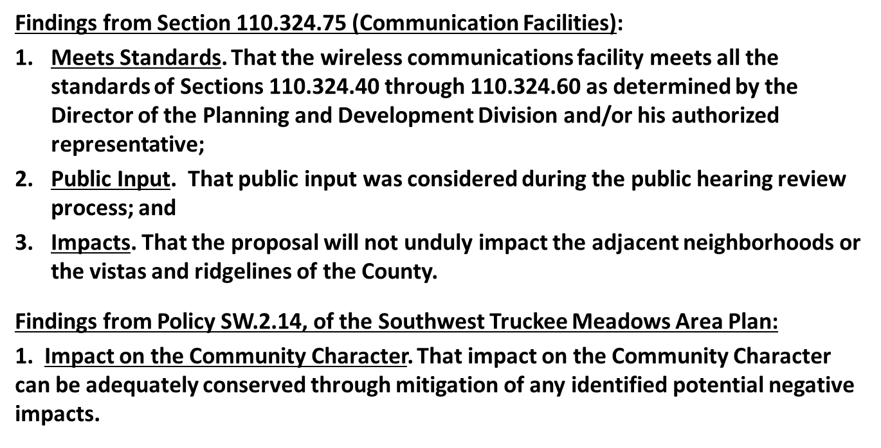
Motion Findings

Slide 37
Appeal Process
Board of Adjustment action will be effective 10 calendar days after the written decision is filed with the Secretary to the Board of Adjustment and mailed to the applicant, unless the action is appealed to the Washoe County Board of County Commissioners, in which case the outcome of the appeal shall be determined by the Washoe County Board of County Commissioners. Any appeal must be filed in writing with the Planning and Development Division within 10 calendar days after the written decision is signed by and filed with the Secretary to the Board of Adjustment, and mailed to the applicant.

